Slide 1

Vacunassist
Here is where this template begins

Slide 2
Project tools infographics
Problem statement
1
2
3
Problem
Solution
Results
Mars is actually a very cold place, not hot
Neptune is the farthest planet from the Sun
Saturn is the ringed planet. It’s a gas giant
Venus has a beautiful name
Mercury is the smallest planet
Neptune is far away from us
$25,000
$36,000
$15,000

Slide 3
Project tools infographics
Problem statement
Problem statement | Mercury is the smallest planet Venus is the second planet from the Sun
Scope | Neptune is far away from Earth Jupiter is the biggest planet of them all
Goal | Saturn is the ringed planet and a gas giant Earth is the planet we live on
Benefits | Mercury is the closest planet to the Sun Pluto is now considered a dwarf planet

Slide 4
Project tools infographics
Process scope
Process | Project group | Key deliveries
Planning scope | Planning | Requirements documents
Collect requirement | Planning | Requirements documents
Define the scope | Planning | Project scope statement
Create WBS | Planning | WBS, WBS dictionary
Validating the scope | Monitoring and controlling | Acceptance of deliverables
Control scope | Monitoring and controlling | Change request

Slide 5
Project tools infographics
Process scope
Scope planning
Scope definition
Scope verification
Scope control
Mercury is the smallest planet of them all
Jupiter is the biggest planet of them all
Despite being red, Mars is a cold place
Venus has a beautiful name but it’s hot

Slide 6
Project tools infographics
S
M
A
R
T
Specific
Measurable
Achievable
Realistic
Timely
Jupiter is the biggest planet
Mars is a cold place, not hot
Mercury is the smallest planet
Saturn is the ringed planet
Venus has a beautiful name

Slide 7
Project tools infographics
S
Specific
Jupiter is the biggest planet
M
Measurable
Mars is a cold place, not hot
A
Achievable
Mercury is the smallest planet
R
Realistic
Saturn is the ringed planet
T
Timely
Venus has a beautiful name

Slide 8
Project tools infographics
Specific
Achievable
Timely
Neptune is far away from us
Mars is a cold place, not hot
Saturn is the ringed planet
S
M
A
R
T
Measurable
Realistic
Mercury is the smallest planet
Venus has a beautiful name

Slide 9
Project tools infographics
Five whys
Why 1
Why 2
Why 3
Why 4
Why 5
Root cause
Venus has a beautiful name
Saturn is the ringed planet
Neptune is far away from Earth
Ceres is in an asteroid belt
Mars is full of iron oxide dust
Neptune is an ice giant
Mercury is the smallest planet
Earth is where we all live
The Moon is a natural satellite
Venus has a beautiful name
Saturn is the ringed planet
Pluto is a dwarf planet. It’s cold
The Sun is a huge star
Mercury is the smallest planet
Mars is a cold place, not hot
Jupiter is the biggest planet
Mars is a cold place, not hot
Venus is also terribly hot
Uranus is an ice giant. It’s cold
Jupiter is the biggest planet

Slide 10
Project tools infographics
Five whys
Define the problem
Why?
Countermeasure
Responsible
Neptune is the farthest planet from the Sun
Jupiter is a gas giant and the biggest planet
Uranus is the seventh planet from the Sun
Why?
Countermeasure
Responsible
Venus is the second planet from the Sun
Despite being red, Mars is a cold place, not hot
Earth is the third planet from the Sun
Why?
Countermeasure
Responsible
Mercury is the closest planet to the Sun
Saturn is a gas giant and has several rings
Ceres is located in the main asteroid belt

Slide 11
Project tools infographics
Cause and effect
Mercury
Venus
It’s the closest planet to the Sun
Venus is the second planet from the Sun
Saturn
Cause and effect
Mars
It’s a gas giant and has several rings
Mars is actually a cold place, not hot
Jupiter
Neptune
Jupiter is the biggest planet of them all
It’s the farthest planet from the Sun

Slide 12
Project tools infographics
Cause and effect
Causes
Effects
1
Mercury is the closest planet to the Sun
Earth is the third planet from the Sun
2
Saturn is a gas giant and has several rings
Neptune is the far away from Earth
3
Jupiter is the biggest planet of them all
Uranus is the seventh planet from the Sun
4
Venus is the second planet from the Sun
Ceres is located in the main asteroid belt
5
Mars is actually a cold place, not hot
Pluto is considered a dwarf planet

Slide 13
Project tools infographics
Cause and effect
Causes |  | Effects
1 | Saturn is a gas giant with rings Earth is the planet we live on |  | The Moon is a natural satellite Venus has a beautiful name
2t | Mercury is the smallest planet Pluto is considered a dwarf planet |  | The Sun is a huge star Jupiter is the biggest planet of them all
3 | Ceres is in an asteroid belt Earth is the planet we live on |  | Saturn is the ringed planet and a gas giant Earth is the planet we live on
4 | Neptune is far away from Earth Uranus is an ice giant |  | Mercury is the closest planet to the Sun Venus has a poisonous atmosphere

Slide 14
Project tools infographics
Cause and effect
Cause 01
Effect 01
Action 01
Mercury is the smallest planet
Venus has a beautiful name
Mars is a cold place, not hot
Cause 02
Effect 02
Action 02
Earth is the planet we live on
Jupiter is the biggest planet
Neptune is far away from Earth
Cause 03
Effect 03
Action 03
Uranus is an ice giant
The Moon is a natural satellite
Ceres is in an asteroid belt
Cause 04
Effect 04
Action 04
Pluto is a dwarf planet
The Sun is a huge star
Neptune is an ice giant

Slide 15
Project tools infographics
Affinity diagram
Group 1
Group 2
Group 3
Group 4
Group 5
Mercury is the smallest planet
Mars is full of iron oxide dust
Pluto is a dwarf planet. It’s cold
Neptune is far away from Earth
Mercury is the smallest planet
The Moon is a natural satellite
Uranus is an ice giant. It’s cold
Saturn is the ringed planet
Earth is where we all live
The Moon is a natural satellite
The Sun is a huge star
Ceres is in an asteroid belt
Mars is a cold place, not hot
Pluto is a dwarf planet. It’s cold
The Sun is a huge star
Venus has a nice name
Earth is where we all live
Jupiter is the biggest planet
Venus has a nice name
Uranus is an ice giant. It’s cold

Slide 16
Project tools infographics
Affinity diagram
Environment
Workspace
People
Process
Uranus is an ice giant. It’s cold
Mars is full of iron oxide dust
Neptune is far away from Earth
Earth is where we all live
Venus has a beautiful name
Saturn is the ringed planet
The Moon is a natural satellite
Ceres is in an asteroid belt
Mercury is the smallest planet
Mars is a cold place, not hot
The Sun is a huge star
Pluto is a dwarf planet. It’s cold
Earth is where we all live
Jupiter is the biggest planet

Slide 17
Project tools infographics
Tally chart
Month | Tally | Days
January |  | 15
February |  | 25
March |  | 20
April |  | 30

Slide 18
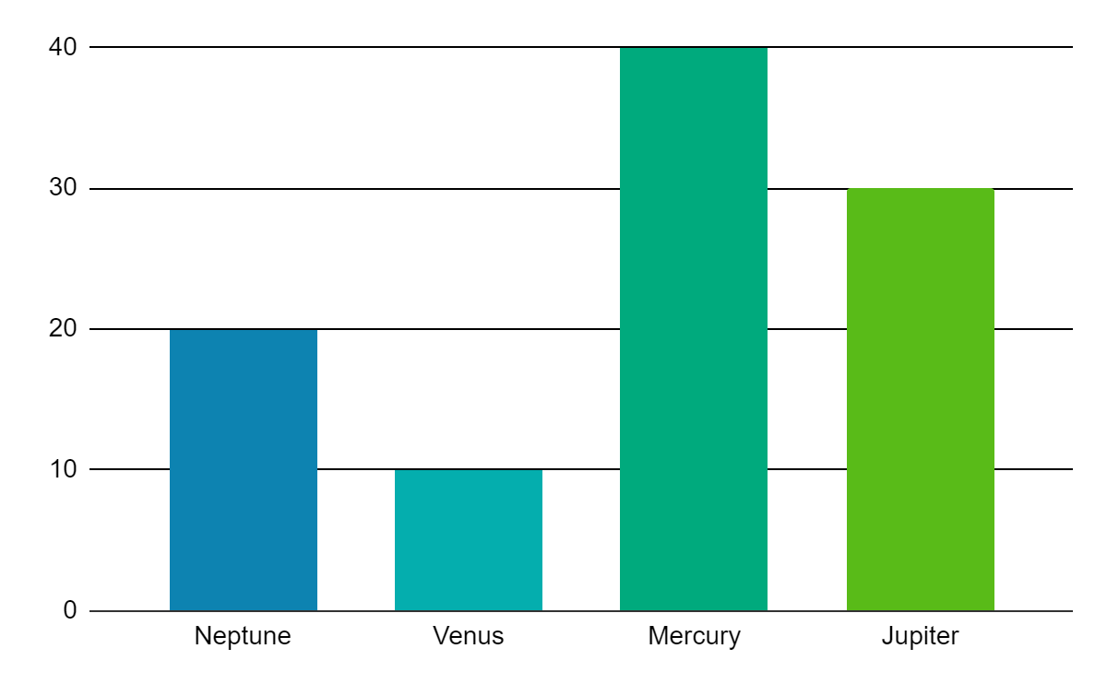
Project tools infographics
Histogram
Neptune
Venus
Neptune is far away from Earth
Venus is the second planet from the Sun
Mercury
Jupiter
Mercury is the smallest planet
Jupiter is the biggest planet
Follow the link in the graph to modify its data and then paste the new one here. For more info, click here

Slide 19
Project tools infographics
Facilitation skills
Presentation
Training
Facilitation
Mars is actually a very cold place, not hot
Jupiter is the biggest planet in the Solar System
Saturn is a gas giant and has several rings
Focus
Mercury is the closest planet to the Sun
Venus is the second planet from the Sun
Ceres is located in the main asteroid belt
Outcome
Neptune is the farthest planet from the Sun
Uranus is the seventh planet from the Sun
Pluto is considered a dwarf planet. It’s cold
Approach

Slide 20
Project tools infographics
Facilitation skills
Training | Presenting | Facilitation
Mars is actually a very cold place, not hot | Jupiter is the biggest planet in the Solar System | Earth is the third planet from the Sun
Mercury is the closest planet to the Sun | Venus is the second planet from the Sun | Ceres is located in the main asteroid belt
Neptune is the farthest planet from the Sun | Uranus is the seventh planet from the Sun | The Sun is the star at the center of the Solar System

Slide 21
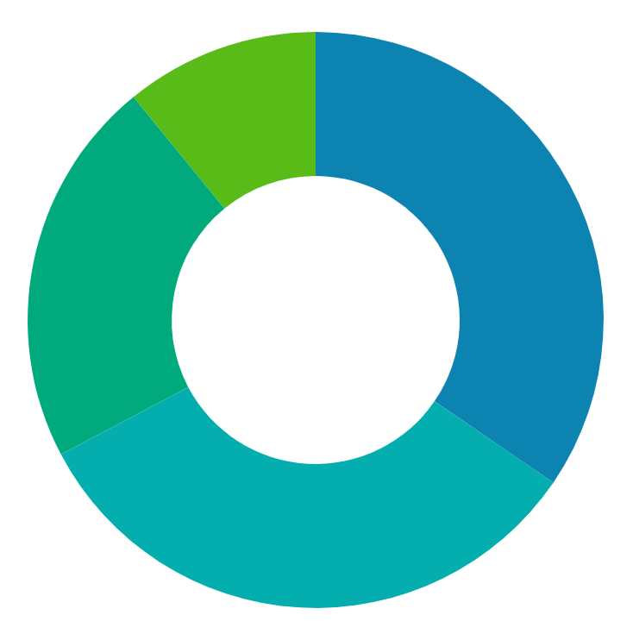
Project tools infographics
Working in teams
Jupiter
10%
40%
Neptune
Jupiter is the biggest planet
Neptune is far away from Earth
Mercury
20%
30%
Venus
Mercury is the smallest planet
Venus is the second planet from the Sun
Follow the link in the graph to modify its data and then paste the new one here. For more info, click here

Slide 22
Project tools infographics
Working in teams
Enterprise
Work
Material
Cost
Team
Generic
Named
Budget
Expensed

Slide 23
Project tools infographics
Check sheets
Project name:
Project manager: |  |  |  |  |  | Date:
Defect | Sun | Mon | Tue | Wed | Thu | Fri | Sat
Mercury
Jupiter
Saturn
Mars

Slide 24
Project tools infographics
Brainstorming and brainwriting
1
2
3
4
5
First ideas
Extra ideas
Extra ideas
Extra ideas
Best ideas
Mars is actually a very cold place
Neptune is far away from Earth
Uranus is an ice giant. It’s cold
Ceres is in the main asteroid belt
Neptune is far away from Earth
Jupiter is the biggest planet
Venus is the second planet from the Sun
Saturn is a gas giant with rings
The Moon is Earth’s only natural satellite
Venus is the second planet from the Sun
Mercury is the smallest planet
The Sun is a huge and hot star
Pluto is considered a dwarf planet
Mercury is the smallest planet
Jupiter is the biggest planet

Slide 25
Project tools infographics
Brainstorming and brainwriting
Mars
Moon
Jupiter
Idea 1
Idea 2
Earth
Saturn
Mars
Main idea
Mars is actually a very cold place, not hot
Venus
Jupiter
Mercury
Idea 4
Idea 3
Saturn
Neptune
Mercury

Slide 26
Project tools infographics
High level goal project planning
Neptune
Mars
Saturn
Neptune is far away from Earth
Mars is a cold place, not hot
Saturn is the ringed planet
Aug 21
Sep 21
Oct 21
Nov 21
Dec 21
Jan 22
Mercury
Venus
Jupiter
Mercury is the smallest planet
Venus has a beautiful name
Jupiter is the biggest planet

Slide 27
Project tools infographics
High level goal project planning
Project initiation
Mercury is the smallest planet
Venus is the second planet from the Sun
Project planning
Neptune is far away from Earth
Jupiter is the biggest planet of them all
Project execution
Saturn is the ringed planet and a gas giant
Earth is the planet we live on
Project closure
Ceres is in the main asteroid belt
Pluto is now considered a dwarf planet

Slide 28
Project tools infographics
Paired comparison
 | A | B | C | D | E | F
Mercury |  | A | A | A | A | A
Jupiter |  |  | B | B | G | A
Saturn |  |  |  | D | D | G
Mars |  |  |  |  | G | G
Venus
Neptune

Slide 29
Project tools infographics
Decision matrix
 | Cost | Experience | Communication | Review | Score
Mercury | 5 | 3 | 4 | 1 | 13
Jupiter | 1 | 7 | 5 | 8 | 21
Saturn | 2 | 3 | 2 | 1 | 8
Venus | 4 | 1 | 3 | 2 | 10
Mars | 1 | 3 | 2 | 1 | 7

Slide 30
Project tools infographics
Payoff matrix
Easy to do
Tough to do
Jupiter is a gas giant and the biggest planet
Neptune is the farthest planet from the Sun
Big payoff
Mars is actually a very cold place, not hot
Venus is the second planet from the Sun
Small payoff

Slide 31
Instructions for use
In order to use this template, you must credit Slidesgo in your final presentation.
You are allowed to:
- Modify this template.
- Use it for both personal and commercial projects.
You are not allowed to:
- Sublicense, sell or rent any of Slidesgo Content (or a modified version of Slidesgo Content).
- Distribute Slidesgo Content unless it has been expressly authorized by Slidesgo.
- Include Slidesgo Content in an online or offline database or file.
- Offer Slidesgo templates (or modified versions of Slidesgo templates) for download.
- Acquire the copyright of Slidesgo Content.
For more information about editing slides, please read our FAQs or visit Slidesgo School:
https://slidesgo.com/faqs and https://slidesgo.com/slidesgo-school

Slide 32
Instructions for use (premium users)
As a Premium user, you can use this template without attributing Slidesgo
You are allowed to:
Modify this template.
Use it for both personal and commercial purposes.
Hide or delete the “Thanks” slide and the mention to Slidesgo in the credits.
Share this template in an editable format with people who are not part of your team.
You are not allowed to:
Sublicense, sell or rent this Slidesgo Template (or a modified version of this Slidesgo Template).
Distribute this Slidesgo Template (or a modified version of this Slidesgo Template) or include it in a database or in any other product or service that offers downloadable images, icons or presentations that may be subject to distribution or resale.
Use any of the elements that are part of this Slidesgo Template in an isolated and separated way from this Template.
Register any of the elements that are part of this template as a trademark or logo, or register it as a work in an intellectual property registry or similar.
For more information about editing slides, please read our FAQs or visit Slidesgo School:
https://slidesgo.com/faqs and https://slidesgo.com/slidesgo-school

Slide 33
Infographics
You can add and edit some infographics to your presentation to present your data in a visual way.
Choose your favourite infographic and insert it in your presentation using Ctrl C + Ctrl V or Cmd C + Cmd V in Mac.
Select one of the parts and ungroup it by right-clicking and choosing “Ungroup”.
Change the color by clicking on the paint bucket.
Then resize the element by clicking and dragging one of the square-shaped points of its bounding box (the cursor should look like a double-headed arrow). Remember to hold Shift while dragging to keep the proportions.
Group the elements again by selecting them, right-clicking and choosing “Group”.
Repeat the steps above with the other parts and when you’re done editing, copy the end result and paste it into your presentation.
Remember to choose the “Keep source formatting” option so that it keeps the design. For more info, please visit Slidesgo School.

